Slide 1
File Streams

Slide 2
Due this week
HW 5
Write solutions in VSCode and paste in CodeRunner.
Extra-credit
Zip your .cpp files and submit on canvas. Check the due date! No late submissions!!
Mandatory Grading Interview - Oct 3rd – 12th!
Quiz 5. Check the due date! No late submissions!

Slide 3
Today
Streams
Reading from files

Slide 4
Streams

Slide 5

Streams
A very famous bridge
over a “stream”

Slide 6

Streams
A ship

Slide 7
Streams
in the stream

Slide 8
Streams
one at a time

Slide 9
Streams
A stream of ships

Slide 10
Streams
No more ships in the stream at this point
Let’s process the inputs we have so far

Slide 11
Streams
Aaahhh… a delicious stream of sushi…
(on conveyor belt)
One at a time
Input to your belly

Slide 12
Streams
Aaahhh… a delicious stream of sushi…
(on conveyor belt)
One at a time
Input to your belly
Eventually, no more sushi
(restaurant closes)

Slide 13
Reading and Writing Files
The C++ input/output library is based on the concept of streams.
An input stream is a source of data.
An output stream is a destination for data.
The most common sources and destinations for data are the files on your hard disk.
You need to know how to read/write disk files to work with large amounts of data that are common in business, administrative, graphics, audio, and science/math programs

Slide 14
Streams
This is a stream of characters. It could be from the keyboard or from a file. Each of these is just a character - even these: 3 -23.73 which, when input, can be converted to: ints or doubles or whatever type you like. (that was a '\n' at the end of the last line) &*@&^#!%#$ (No, that was –not- a curse!!!!!!!!!! ¥1,0000,0000 (price of a cup of coffee in Tokyo) Notice that all of this text is very plain - No bold or green of italics – just characters – and whitespace (TABs, NEWLINES and, of course... the other one you can’t see: the space character: (another '\n') (&& another)
Notes:
Ask the students: how many newline characters are in this text (stream)?

Slide 15
Streams
This is a stream of characters. It could be from the keyboard or from a file. Each of these is just a character - even these: 3 -23.73 which, when input, can be converted to: ints or doubles or whatever type you like. (that was a '\n' at the end of the last line) &*@&^#!%#$ (No, that was –not- a curse!!!!!!!!!! ¥1,0000,0000 (price of a cup of coffee in Tokyo) Notice that all of this text is very plain - No bold or green of italics – just characters – and whitespace (TABs, NEWLINES and, of course... the other one you can’t see: the space character: (another '\n') (&& another)
Aren’t you x-STREAM-ly glad this stream is over?
And there were no sound effects!!!
Notes:
Ask the students: how many newline characters are in this text (stream)?

Slide 16
Streams
newline characters
This is a stream of characters. It could be from the keyboard or from a file. Each of these is just a character - even these: 3 -23.73 which, when input, can be converted to: ints or doubles or whatever type you like. (that was a '\n' at the end of the last line) &*@&^#!%#$ (No, that was –not- a curse!!!!!!!!!! ¥1,0000,0000 (price of a cup of coffee in Tokyo) Notice that all of this text is very plain - No bold or green of italics – just characters – and whitespace (TABs, NEWLINES and, of course... the other one you can’t see: the space character: (another '\n') (&& another) (more whitespace) and FINALLY:
Aren’t you x-STREAM-ly glad this stream is over?
And there were no sound effects!!!
Notes:
Ask the students: how many newline characters are in this text (stream)?

Slide 17
Reading and Writing Streams
The stream you just saw is a plain text file.
No formatting, no colors, no video or music (or sound effects).
A program can read these sorts of plain text streams of characters from the keyboard, as has been done so far with cin.

Slide 18
Reading and Writing Disk Files
You can also read and write files stored on your hard disk:
plain text files
binary information (a binary file)
Such as images or audio recording
To read/write files, you use variables of the stream types:
ifstream for input from plain text files.
ofstream for output to plain text files.
fstream for input and output from binary files.
You must #include <fstream>

Slide 19
Opening a Stream
To read anything from a file stream, you need to open the stream. (The same for writing.)
Opening a stream means associating your stream variable with the disk file.
The first step in opening a file is having the stream variable ready.

Slide 20
Opening a Stream
To read anything from a file stream, you need to open the stream. (The same for writing.)
Opening a stream means associating your stream variable with the disk file.
The first step in opening a file is having the stream variable ready.
Here’s the definition of an input stream variable named in_file:
ifstream in_file;
Looks suspiciously like every other
variable definition you’ve done
– it is!
Only the type name is new to you.

Slide 21
Code for opening a stream
ifstream in_file;
in_file.open("input.txt"); //filename is input.txt
An alternative shorthand syntax combines the 2 statements:
ifstream in_file(“input.txt”);
As your program runs and tries to find this file, it WILL ONLY LOOK IN THE DIRECTORY (FOLDER) IT IS LOCATED IN!
This is a common source of errors. If the desired file is not in the executing program’s folder, the full file path must be specified.

Slide 22
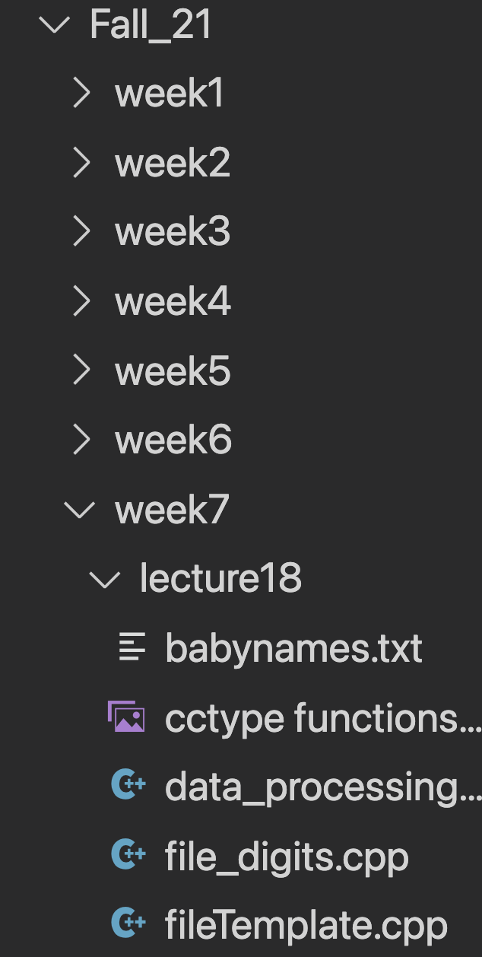
File Path Names
File names can contain directory path information, such as:
UNIX in_file.open("~/nicework/input.dat");
Windows in_file.open("c:\\nicework\\input.dat");
When you specify the file name as a string literal, and the name contains backslash characters (as in Windows), you must supply each backslash twice to avoid having unintended escape characters in the string.
\\ becomes a single \ when processed by the compiler.

Slide 23
Failing to open
The open method also sets a “not failed” condition
It is a good idea to test for failure immediately:
in_file.open(filename);
// Check for failure after opening
if (in_file.fail()) if(!in_file.is_open())
{ {
return 0; or return 0;
} }

Slide 24
Closing a Stream
When the program ends, all streams that you have opened will be automatically closed.
You can manually close a stream with the close member function:
in_file.close();
Create variable
Open file (provide filename)
Check if file opened successfully
Read from file
Close file

Slide 25
Reading from a stream
If you have the following stored in a file:
CSCI 1300
You already know how to read and write using files.
Yes you do:
string name;
int number;

Slide 26
Reading from a stream
If you have the following stored in a file:
CSCI 1300
You already know how to read and write using files.
Yes you do:
string name;
int number;
in_file >> name >> number;

Slide 27
Reading from a stream
You already know how to read and write using files.
Yes you do:
string name;
int number;
in_file >> name >> number;
cin? in_file?
No difference when it comes to reading using >>.

Slide 28
Reading from a stream
The >> operator returns a “not failed” condition, allowing you to combine an input statement and a test.
A “failed” read yields a false and a “not failed” read yields a true.
if (in_file >> name >> number)
{
// Process input
}

Slide 29
Reading from a stream
You can even read ALL the data from a file because running out of things to read causes that same “failed state” test to be returned:
while (in_file >> name >> number)
{
// Process input
}

